Slide 1
Red Black Tree Case Study

Slide 2
What is a Red-Black Tree?
• A Red-Black Tree (RBT) is a self-balancing Binary Search Tree (BST).
• Each node has an extra bit for color (Red or Black).
• Ensures operations like insertion, deletion, and search take O(log n) time.
• Maintains approximate balance using color properties and rotations.

Slide 3
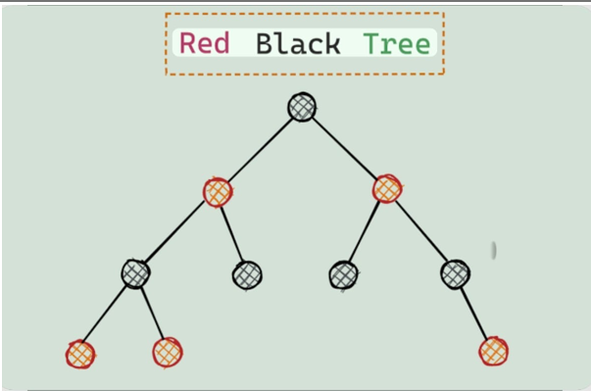

Slide 4
Need for Balancing
Normal BST can become unbalanced (like a linked list).
• Causes poor performance — O(n) time complexity.
• RBT automatically adjusts structure to remain balanced

Slide 5
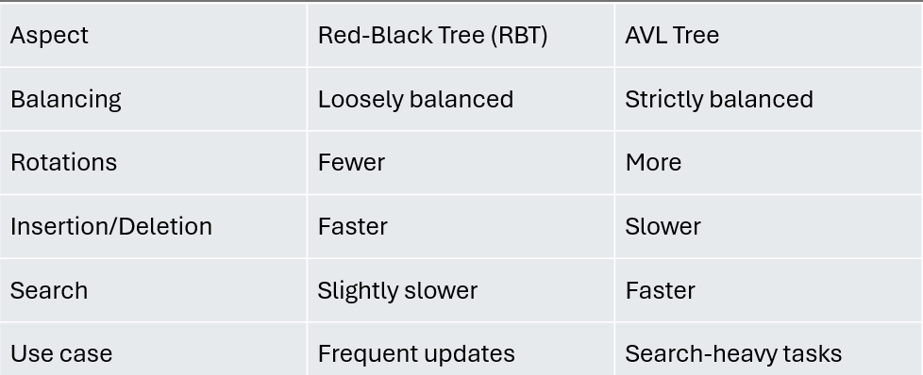
Comparison with AVL Tree

Slide 6
NODES STRUCTURE’S
Each node in a Red-Black Tree stores data and extra information to help the tree stay balanced.
Key / Value → The actual data stored in the node
Color Bit → Indicates whether the node is Red or Black
Left Child Pointer → Points to the left subtree
Right Child Pointer → Points to the right subtree
Parent Pointer → Helps navigate upward during rotations and fixes

Slide 7
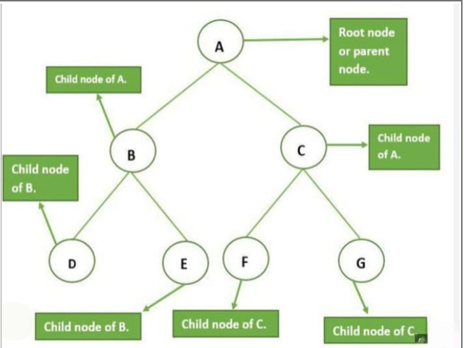

Slide 8
Key Properties Of Red Black Tree
A Red - Black Tree is a type of self-balancing binary search tree that follows specific color rules to maintain balance after insertions and deletions.
Every node is either Red or Black.
The Root node is always Black.
All NIL (leaf) nodes are Black.
If a node is Red, then both its children are Black (no two reds in a row).
Every path from a node to its descendant NIL nodes has the same number of Black nodes (called Black Height).

Slide 9
Black Height Concept
Definition:
Black Height = Number of black nodes on any path from a node to a NIL (leaf) node.
Balance Indicator:
Every path from the root to NIL has the same black height, ensuring uniform depth.
Why It Matters:
This rule keeps the tree approximately balanced, giving efficient operations in O(log₂ n) time.
Visual Intuition:
Imagine counting black beads along each root-to-leaf path — each path must have the same number, keeping the tree steady and fair!

Slide 10
Validity of Red – Black Tree
Valid RBT
Ensures efficient and balanced search performance
No two consecutive red nodes
Equal black height on all root-to-leaf paths
In Valid RBT
Two red nodes in a row (violates property 4)
Unequal black height across paths (violates property 5)
Root not black, or leaf NILs not black

Slide 11
Red-Black Tree Operations
Search:
Works like a Binary Search Tree (BST).
Example: Traverses left or right until found or null.
- Complexity: O(log n)
2. Insert:
Insert new node like BST, color it red.
Fix violations using recoloring or rotations.
Complexity: O(log n)
3. Delete:
Perform standard BST delete.
Fix double-black or color violations using

Slide 12
Tree Rotations in Red-Black Trees
Explain how left and right rotations help maintain the Red-Black Tree balance.
1. Left Rotation:
Used when a right-heavy subtree causes imbalance.
The parent node moves left, and the right child becomes the new parent.
2. Right Rotation:
Used when a left-heavy subtree causes imbalance.
The parent node moves right, and the left child becomes the new parent.
How Rotations Maintain BST Property:
They rearrange the tree locally without changing the in-order sequence of nodes.
Hence, the Binary Search Tree (BST) property remains intact.
Note:
Rotations are the building blocks of rebalancing during insertion and deletion

Slide 13
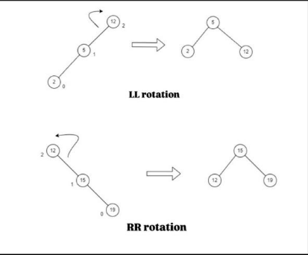
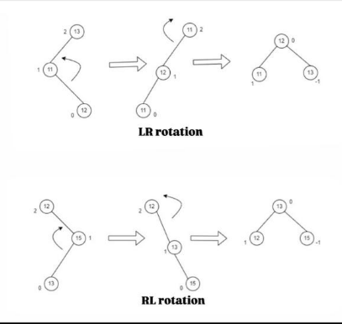

Slide 14
Fixing Violations in Red-Black Trees
Show step-by-step how violations are corrected after insertion or deletion.
Step 1: Identify Violation Type
→ Happens after insertion or deletion.
→ Check if the parent and uncle nodes are red or black.
Step 2: Fix Cases After Insertion
Case 1 - Uncle is Red:
→ Recolor parent and uncle black, grandparent red.
→ Move up and recheck.
Case 2 - Uncle is Black (Triangle Case):
→ Rotate to make line alignment (e.g., left-right or right-left).
Case 3 - Uncle is Black (Line Case):
→ Rotate grandparent and recolor to restore balance

Slide 15
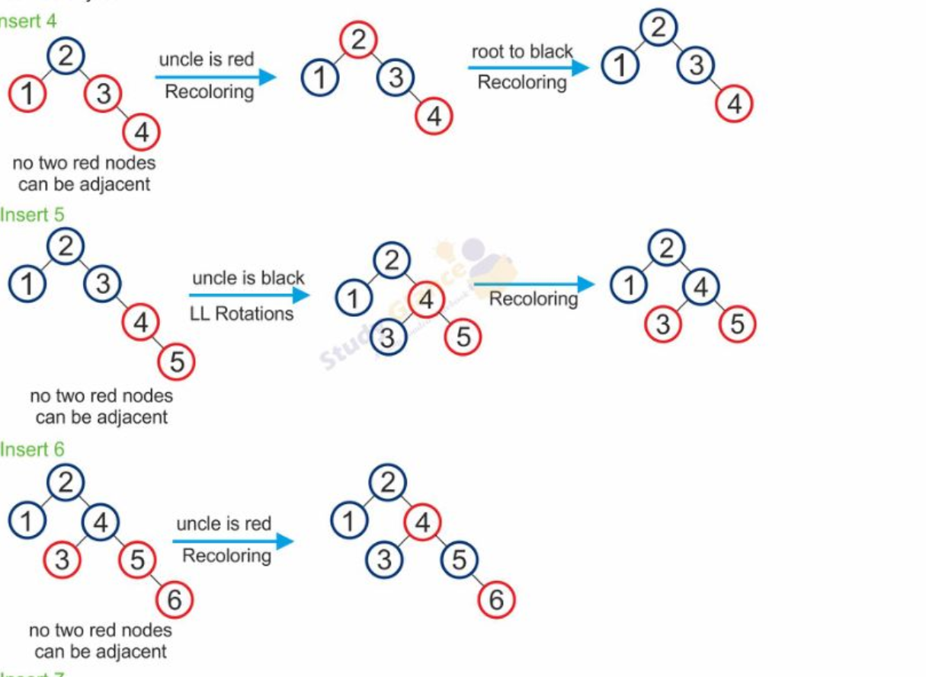

Slide 16
Deletion Algorithm in Red-Black Trees
Steps:
1. Standard BST Delete:
-Perform deletion as in a normal Binary Search Tree (BST).•
- If the deleted node or its replacement is black, it may cause imbalance.
2 . Fix Double-Black or Color Violations:
- When a black node is deleted, a double-black situation may occur.
-Handle by checking sibling colors and performing rotations or recolors.
3. Recolor or Rotate:
- If sibling is red → rotate around parent and recolor.
- If sibling is black → recolor and move double-black up

Slide 17
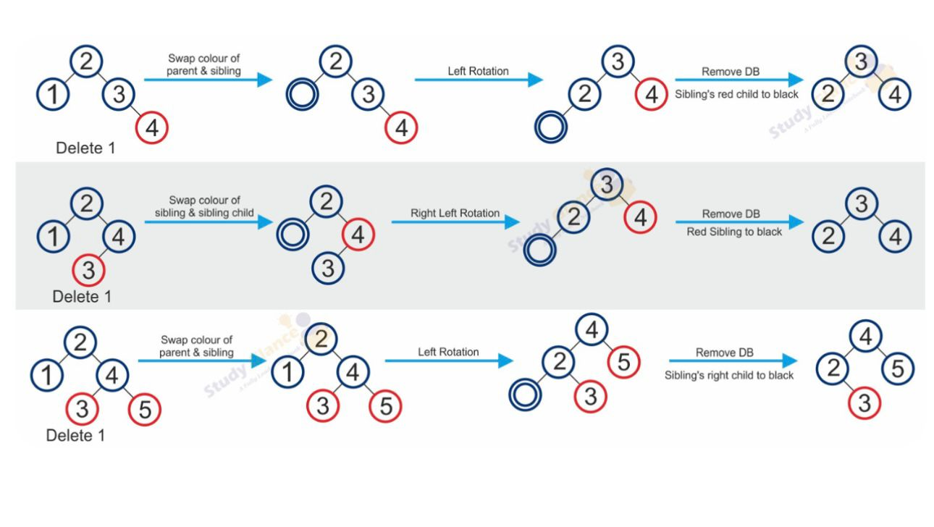

Slide 18
Example Insertion Sequence
Insertion begins like a normal Binary Search Tree (BST) by comparing values and finding the correct position.
Every newly inserted node is initially colored red to avoid unnecessary black-height violations.
After insertion, the tree is checked for violations of Red-Black properties (e.g., red parent).
If violations occur, the fix-up steps (recoloring or rotations) are applied to restore balance.
The process guarantees that the tree remains approximately balanced after every insertion.

Slide 19
Balancing Demonstration
Recoloring is used when the parent and uncle of the new node are red, flipping colors to maintain properties.
Left rotation is applied when a right-leaning violation occurs to bring the structure back to balanced form.
Right rotation is used when a left-leaning violation occurs to correct imbalance.
Rotations ensure no red node has a red child, maintaining the self-balancing property.
The combination of recoloring and rotations ensures consistent O(log n) height.

Slide 20
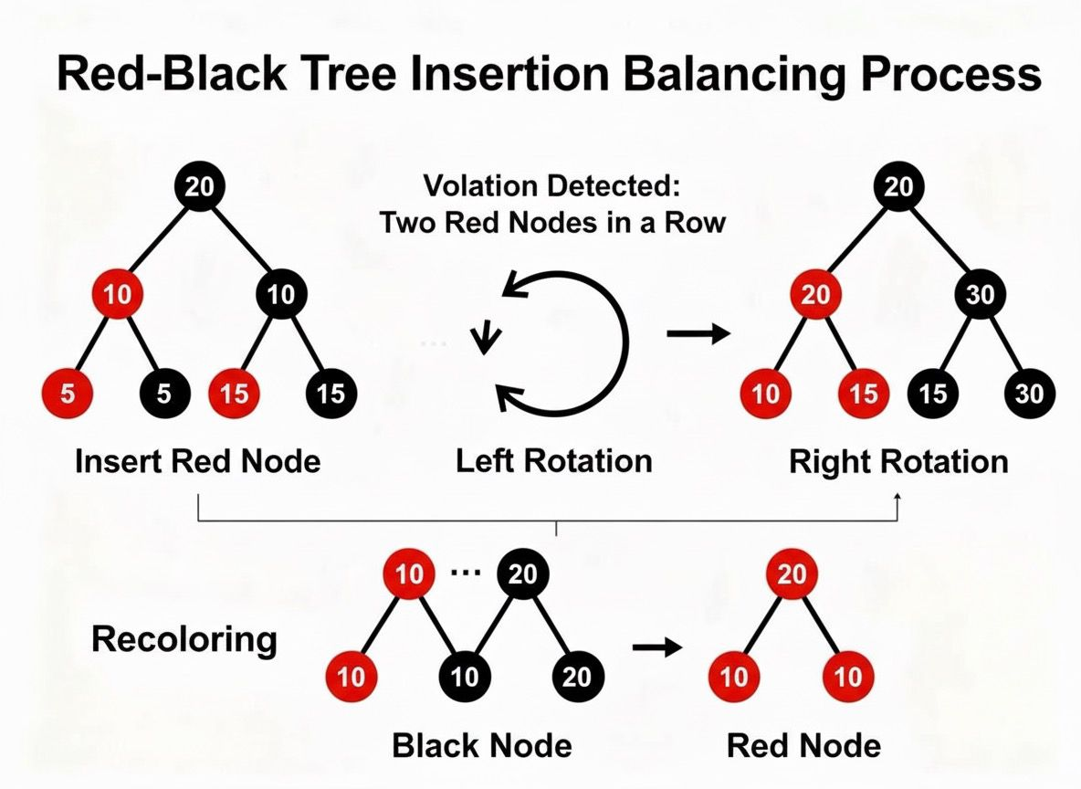

Slide 21
Performance Comparison : BST VS RBT
BST can become skewed (like a linked list), leading to worst-case O(n) operations.
RBT always maintains balanced height, ensuring O(log n) operations for insert, delete, and search.
RBT uses extra color information to preserve structure with minimal overhead.
BST performance heavily depends on input order; RBT performance is stable regardless of input order.
RBT provides predictable time complexity, making it suitable for real-time and system-level operations.

Slide 22
Summary, Conclusion & Application
Red-Black Trees guarantee balanced search performance through structured color rules.
They efficiently handle large dynamic datasets that require frequent insertions and deletions.
RBTs are widely used in implementing associative containers like maps and sets.
Operating systems and databases use RBTs for memory management and indexing.
Their reliable worst-case guarantees make them ideal for performance-critical applications.

